Slide 1


G.H. RAISONI COLLEGE OF ENGINEERING AND MANAGEMENT, WAGHOLI, PUNE
DepartmentofCSE ( AI&AIML)
Employee Attrition Prediction System using ML
Guide:
Prof. Pravin Thakare
Name of Projectees:
Vaibhav Chole C-41
Vaishnavi Jadhav C-43
Vaishnavi Kahakar C-44

Slide 2

Contents
Contents
Introduction
Justifications for Selecting the title
Problem Statement
Objective
Scope
Literature Review
System Architecture
Methodology
Tools Used
Plan of Work
References

Slide 3

Introduction
Employee attrition refers to employees leaving an organization over time
Can occur due to resignation, retirement, or job dissatisfaction
High employee attrition increases recruitment and training costs
Loss of skilled and experienced employees affects productivity
Employee attrition impacts organizational growth and stability
Attrition occurs due to multiple factors like job satisfaction, salary, workload, and work-life balance
Organizations face difficulty in identifying employees who may leave early
Traditional HR methods are reactive and inefficient

Slide 4
Justifications for Selecting the
Employee attrition is a major challenge faced by organizations across industries
High attrition leads to increased recruitment and training costs
Loss of skilled employees affects productivity and organizational growth
Employee attrition depends on multiple factors and is difficult to predict manually
Machine learning helps analyze large HR datasets efficiently
Data-driven prediction can help organizations take early preventive actions
The topic is relevant to real-world HR analytics applications
The project aligns with current trends in artificial intelligence and machine learning

Slide 5
Problem Statement
Employee attrition is a serious challenge for modern organizations 🏢
Employees often leave jobs unexpectedly ❌ without prior notice
Reasons include:
Job dissatisfaction 😞
Work pressure and stress ⚠
Lack of career growth 📉
Sudden attrition causes:
  Financial loss 💰
  Increased hiring and training costs 📚
  Reduced productivity 📉
HR teams cannot easily identify high-risk employees in advance ❓
There is a need for an intelligent, data-driven solution 🤖
This project uses Machine Learning 📊 to predict employee attrition early ⏳
Helps organizations take preventive actions and improve retention 🤝

Slide 6
Objective
Objective
To study the concept of employee attrition in organizations
To understand the causes and impact of employee attrition
To analyze HR employee data related to attrition
To identify important factors influencing employee attrition
To explore the use of machine learning techniques for attrition prediction
To design a proposed system for employee attrition prediction
To compare different machine learning approaches conceptually
To support data-driven decision making in HR management
To help organizations reduce employee turnover through early prediction

Slide 7
Scope
Scope
The project focuses on analyzing employee attrition using HR data
It considers multiple factors such as job satisfaction, salary, experience, and workload
The scope is limited to structured HR datasets
The proposed system aims to predict employee attrition as Yes or No
The project is applicable to organizations of different sizes
The system supports HR decision-making for employee retention
The scope is limited to prediction and analysis, not policy implementation

Slide 8

Literature Review
Sr. No. | Paper Title and Year | Details of Publication | Findings
1 | From Big Data to Deep Data to Support People Analytics for Employee Attrition Prediction (2021) | IEEE Access, Volume 9, Pages 67345–67358 Authors: Yahia, N. B., Hlel, J., & Colomo-Palacios, R. | The paper focuses on people analytics and data quality for predicting employee attrition. It highlights the importance of meaningful HR data but does not present a complete end-to-end prediction system.
2 | Employee Attrition Prediction Using Machine Learning Techniques (2021) | Proceedings of the International Conference on Intelligent Computing and Control Systems (ICICCS), Pages 112–118 Authors: Mishra, S., Patnaik, S., & Panda, S. | The study applies machine learning algorithms such as Logistic Regression and Random Forest to predict employee attrition and shows improved prediction accuracy.
3 | Predicting Employee Turnover Using Data Mining Techniques (2020) | Procedia Computer Science, Volume 167, Pages 210–219 Authors: Kumar, A., Jain, R., & Kaur, P. | The research analyzes HR factors influencing employee attrition using Decision Tree and Naïve Bayes classifiers and identifies job satisfaction as a key factor.
4 | Employee Attrition Prediction Using Support Vector Machine and KNN (2019) | Journal of Intelligent Systems, Volume 28(4), Pages 589–602 Authors: Zhang, Y., Li, X., & Wang, H. | The paper uses SVM and KNN models to predict employee turnover and reports improved classification performance with higher computational cost.
5 | A Survey on Employee Attrition Prediction Using Machine Learning (2022) | International Journal of Computer Applications, Volume 174(21), Pages 12–18 Authors: Patel, R., Shah, D., & Mehta, K. | This survey reviews multiple machine learning approaches for employee attrition prediction and highlights the need for accurate and scalable predictive systems.

Slide 9
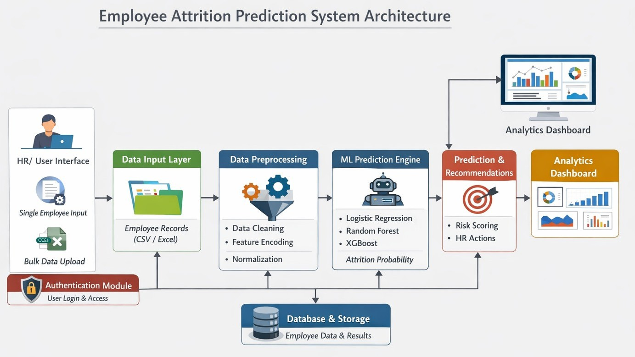
System Architecture
Problem Statement

Slide 10


Methodology
1. Data Collection
HR employee data is collected from a reliable dataset
Data includes personal, job, and performance-related attributes
2. Data Preprocessing
Missing and inconsistent data is handled
Categorical data is converted into numerical format
3. Feature Selection
Important features influencing employee attrition are identified
Irrelevant or redundant features are removed
Data Collection
Feature Selection
Model Training
Model Evaluation
Preprossing
4. Model Training
Machine learning algorithms are applied to train the model
The model learns patterns related to employee attrition
5. Model Evaluation
Model performance is evaluated using appropriate metrics
Results are analyzed to support attrition prediction

Slide 11
Technology & Tools
Technology Stack
Database & Storage 🗄
SQLite for employee data storage
Stores uploaded files, prediction
results, and HR actions
Visualization & Analytics 📊
Matplotlib, Seaborn, Plotly
Charts, dashboards.
Department-wise and role-wise
attrition insights
Tools & Environment 🧰
VS Code for application
development
GitHub / Git for version control
Frontend (User Interface) 🌐
HTML, CSS, JavaScript
Responsive forms for single employee input
and bulk CSV/Excel upload
Interactive charts for analytics dashboard
Backend (Server & Application Logic) ⚙
Python
Handles data processing, ML model integration, and API requests
Session management & user authentication
Machine Learning & Data Science 🤖
Scikit-learn: Logistic Regression, Random Forest
Risk score and probability-based prediction

Slide 12
Plan Of Work
Months Activities | January’26 | February’26 | March’26 | April’26
Literature Reviews | ✓
Requirement Analysis | ✓
Designing | ✓
Experimental Analysis | ✓
Module wise Implementation
Testing and Debugging
Preparation of Project Report

Slide 13

References
Referances
[1]. Yahia, N. B., Hlel, J., & Colomo-Palacios, R. (2021). From Big Data to Deep Data to Support People Analytics for Employee Attrition Prediction. IEEE Access, 9, 67345–67358.
[2]. Mishra, S., Patnaik, S., & Panda, S. (2021). Employee Attrition Prediction Using Machine Learning Techniques. Proceedings of IEEE International Conference on Intelligent Computing and Control Systems.
[3]. Kumar, A., Jain, R., & Kaur, P. (2020). Predicting Employee Turnover Using Data Mining Techniques. Procedia Computer Science, Elsevier.
[4]. Zhang, Y., Li, X., & Wang, H. (2019). Employee Attrition Prediction Using Support Vector Machine and KNN. Springer Journal of Intelligent Systems.
[5]. Patel, R., Shah, D., & Mehta, K. (2022). A Survey on Employee Attrition Prediction Using Machine Learning. International Journal of Computer Applications.

Slide 14

Thank you !

